Slide 1

Hibernate Overview

Slide 2
Topics
•
What is Hibernate?
•
Benefits of Hibernate
•
Code Snippets

Slide 3


What is Hibernate?
•
A framework for persisting / saving Java objects in a database
www.hibernate.org
Your Java App
Hibernate

Slide 4
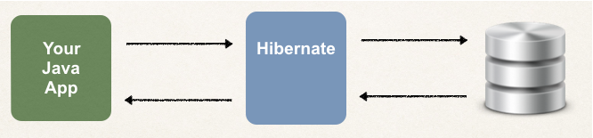
Benefits of Hibernate
•
Hibernate handles all of the low-level SQL
•
Minimizes the amount of JDBC code you have to develop
•
Hibernate provides the Object-to-Relational Mapping (ORM)

Slide 5
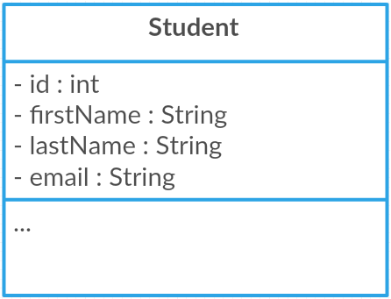
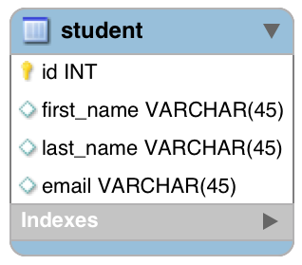
Object-To-Relational Mapping (ORM)
The developer defines mapping between Java class and database table
Java Class
Database Table
Hibernate

Slide 6

Saving a Java Object with Hibernate
// create Java object
Student theStudent = new Student(“John”, “Doe”, “john@luv2code.com");
// save it to database
int theId = (Integer) session.save(theStudent);

Slide 7

Retrieving a Java Object with Hibernate
// create Java object
Student theStudent = new Student(“John”, “Doe”, “john@luv2code.com");
// save it to database
int theId = (Integer) session.save(theStudent);
// now retrieve from database using the primary key
Student myStudent = session.get(Student.class, theId);

Slide 8

Querying for Java Objects
Query query = session.createQuery("from Student",Student.class);
List<Student> students= query.getResultList();

Slide 9
Hibernate CRUD Apps
Create objects
Read objects
Update objects
Delete objects

Slide 10

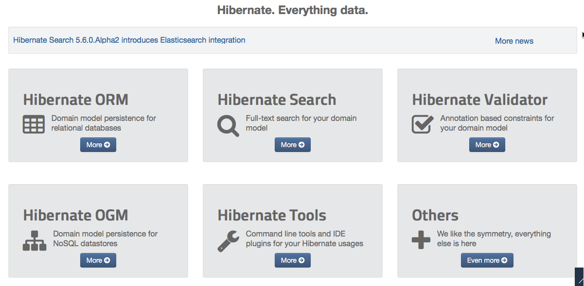
Hibernate is actually more than ORM!

Slide 11

How does Hibernate relate to JDBC?

Slide 12



Hibernate and JDBC
•
Hibernate uses JDBC for all database communications
Your Java App
Hibernate
JDBC

Slide 13
SET UP YOUR ENVIRONMENT

Slide 14
Required Software
To Build Hibernate Applications, you need the following:
Java Integrated Development Environment (IDE)
Database Server
Hibernate JAR files and JDBC Driver

Slide 15
To Do List
Create Eclipse Project
Download Hibernate Files
Download MySQL JDBC Driver
Add JAR files to Eclipse Project … Build Path

Slide 16
Test JDBC Connection

Slide 17
Hibernate Dev Process

Slide 18
To Do List
Add Hibernate Configuration file
Annotate Java Class
Develop Java Code to perform database operations

Slide 19



Configuration File
Hibernate
JDBC

Slide 20
Hibernate Annotation

Slide 21

Terminology
Entity Class
Java class that is mapped to a database table

Slide 22
Object-to-Relational Mapping (ORM)
Java Class
Database Table
Hibernate

Slide 23
Two Options for Mapping
Option 1: XML config file (legacy)
Option 2: Java Annotations (modern, preferred)

Slide 24
Java Annotations
Step 1: Map class to database table
Step 2: Map fields to database columns

Slide 25

Step 1: Map class to database table
@Entity @Table(name="student") public class Student {
...
Java Class
Database Table
}

Slide 26

Step 2: Map fields to database columns
@Entity @Table(name="student") public class Student {
@Id @Column(name="id") private int id;
Java Class
Database Table
@Column(name="first_name")
private String firstName;
…
}

Slide 27
Save a Java Object

Slide 28






Two Key Players
Class Description
SessionFactory | Reads the hibernate config file Creates Session objects Heavy-weight object Only create once in your app
Session | Wraps a JDBC connection Main object used to save/retrieve objects Short-lived object Retrieved from SessionFactory

Slide 29

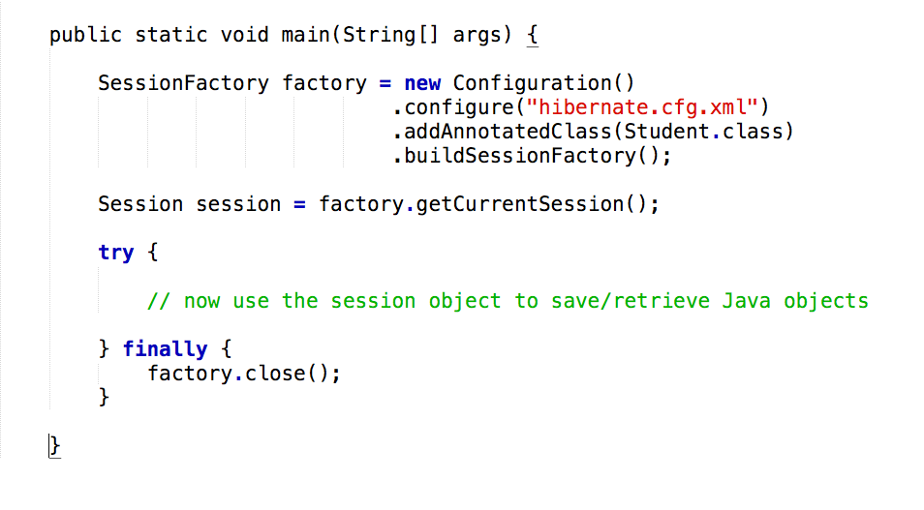
Java Code Setup

Slide 30

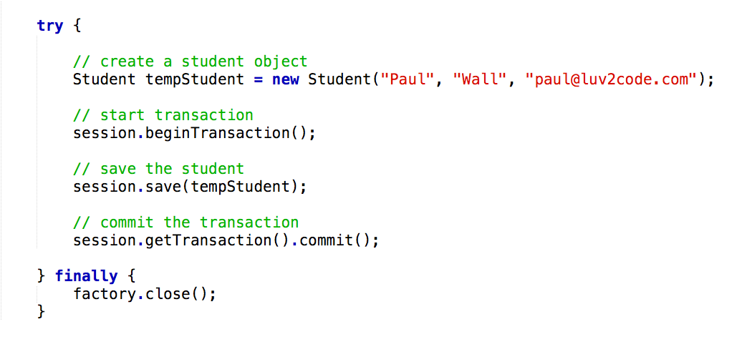
Save a Java Object

Slide 31
Hibernate and Primary Keys

Slide 32

Terminology
Primary Key
Uniquely identifies each row in a table Must be a unique value
Cannot contain NULL values

Slide 33

MySQL - Auto Increment
CREATE TABLE student (
id int(11) NOT NULL AUTO_INCREMENT,
first_name varchar(45) DEFAULT NULL, last_name varchar(45) DEFAULT NULL, email varchar(45) DEFAULT NULL, PRIMARY KEY (id)
)

Slide 34

Hibernate Identity - Primary Key
@Entity @Table(name="student") public class Student {
@Id @Column(name="id") private int id;
…
}

Slide 35

Hibernate Identity - Primary Key
@Entity @Table(name="student") public class Student {
@Id @GeneratedValue(strategy=GenerationType.IDENTITY)
@Column(name="id") private int id;
…
}

Slide 36





ID Generation Strategies
Name | Description
GenerationType.AUTO | Pick an appropriate strategy for the particular database
GenerationType.IDENTITY | Assign primary keys using database identity column
GenerationType.SEQUENCE | Assign primary keys using a database sequence
GenerationType.TABLE | Assign primary keys using an underlying database table to ensure uniqueness

Slide 37
Retrieving an Object

Slide 38
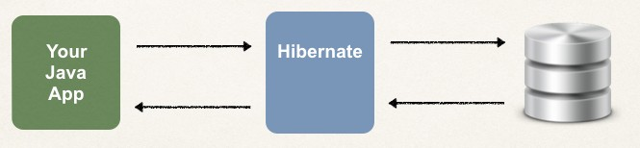
Hibernate CRUD Apps
Create objects
Read objects
Update objects
Delete objects

Slide 39

Retrieving a Java Object with Hibernate
// create Java object
Student theStudent = new Student(“Daffy”, “Duck”, “daffy@luv2code.com");
// save it to database
session.save(theStudent);
…
// now retrieve/read from database using the primary key
Student myStudent =
session.get(Student.class, theStudent.getId());

Slide 40
Querying Objects

Slide 41
Hibernate Query Language (HQL)
Query language for retrieving objects
Similar in nature to SQL
where, like, order by, join, in, etc…

Slide 42

Retrieving all Students
List<Student> theStudents =
session
.createQuery("from Student”,Student.class)
.getResultList();

Slide 43

Retrieving Students: lastName = ‘Doe’
List<Student> theStudents = session
.createQuery("from Student s where s.lastName='Doe’”,Student.class)
.getResultList();

Slide 44

Retrieving Students using OR predicate:
List<Student> theStudents = session
.createQuery("from Student s where s.lastName='Doe'"
+ " OR s.firstName='Daffy'")
.getResultList();

Slide 45

Retrieving Students using LIKE predicate:
List<Student> theStudents = session
.createQuery("from Student s where"
+ " s.email LIKE '%luv2code.com'")
.getResultList();

Slide 46
Updating Object(s)

Slide 47

Update a Student
int studentId = 1;
Student myStudent = session.get(Student.class, studentId);
// update first name to "Scooby" myStudent.setFirstName("Scooby");
// commit the transaction session.getTransaction().commit();

Slide 48
Deleting Object(s)

Slide 49
Delete a Student
int studentId = 1;
Student myStudent = session.get(Student.class, studentId);
// delete the student session.delete(myStudent);
// commit the transaction session.getTransaction().commit();

Slide 50
Hibernate Advanced Mappings

Slide 51
Basic Mapping
Java Class
Database Table
Hibernate

Slide 52
Advanced Mappings
In the database, you most likely will have
Multiple Tables
Relationships between Tables
•
Need to model this with Hibernate

Slide 53
Advanced Mappings
One-to-One
•
One-to-Many, Many-to-One
•
Many-to-Many

Slide 54


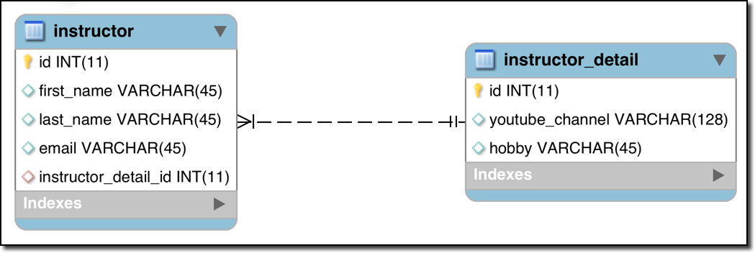
One-to-One Mapping
An instructor can have an “instructor detail” entity
Similar to an “instructor profile”
Instructor Detail
Instructor

Slide 55




One-to-Many Mapping
An instructor can have many courses
Course
Course
Instructor
Course
Course

Slide 56



Many-to-Many Mapping
A course can have many students
A student can have many courses
Course
Student
Course
Student
Course
Student
Course
Student

Slide 57
Important Database Concepts
•
Primary key and foreign key
•
Cascade

Slide 58
Primary Key and Foreign Key
Primary key: identify a unique row in a table
•
Foreign key:
Link tables together
a field in one table that refers to primary key in another table

Slide 59

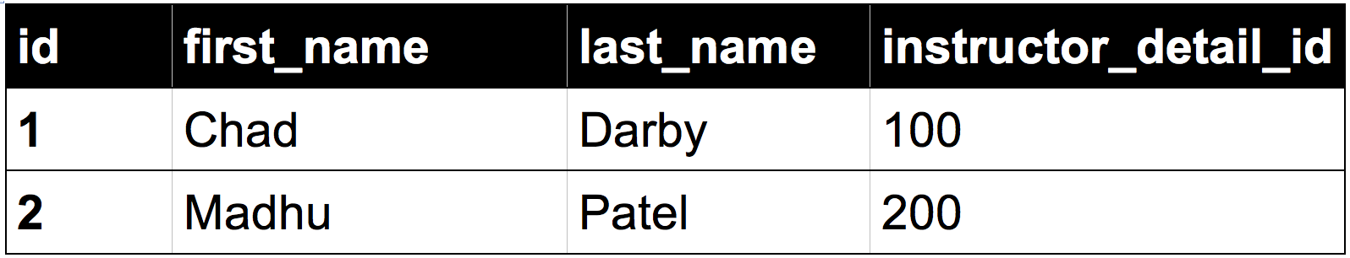
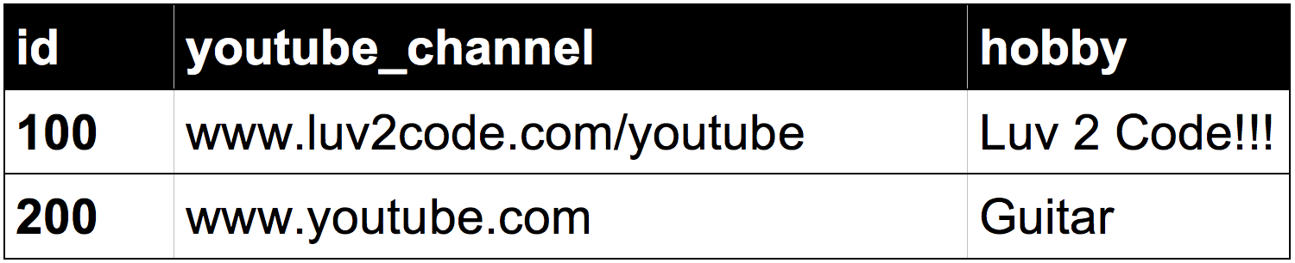

Foreign Key Example
Foreign key column
Table: instructor
Table: instructor_detail

Slide 60



Cascade
You can cascade operations
•
Apply the same operation to related entities
Instructor Detail
Instructor
save

Slide 61

Cascade
If we delete an instructor, we should also delete their instructor_detail
This is known as “CASCADE DELETE”
Instructor Detail
Instructor
delete

Slide 62







Cascade Delete
Foreign key column
Table: instructor
Table: instructor_detail

Slide 63




Cascade Delete
Developer can configure cascading
No way!!!
Cascade delete depends on the use case
Should we do cascade delete here???
Course
Student
Course
Student
Course
Student
Course
Student

Slide 64




Fetch Types: Eager vs Lazy Loading
When we fetch / retrieve data, should we retrieve EVERYTHING?
Eager will retrieve everything
Lazy will retrieve on request
Course
Course
Instructor
Course
Course

Slide 65


Uni-Directional
Instructor Detail
Instructor

Slide 66


Bi-Directional
Instructor Detail
Instructor

Slide 67
Hibernate One-to-One

Slide 68
One-to-One Mapping
An instructor can have an “instructor detail” entity
Similar to an “instructor profile”
Instructor Detail
Instructor

Slide 69
Uni-Directional
Instructor Detail
Instructor

Slide 70
Development Process: One-to-One
Step-By-Step
Prep Work - Define database tables
Create InstructorDetail class
Create Instructor class
Create Main App

Slide 71

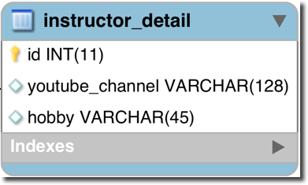
table: instructor_detail
File: create-db.sql
CREATE TABLE `instructor_detail` (
`id` int(11) NOT NULL AUTO_INCREMENT,
`youtube_channel` varchar(128) DEFAULT NULL,
`hobby` varchar(45) DEFAULT NULL,
);
...

Slide 72
table: instructor_detail
File: create-db.sql
CREATE TABLE `instructor_detail` (
`id` int(11) NOT NULL AUTO_INCREMENT,
`youtube_channel` varchar(128) DEFAULT NULL,
`hobby` varchar(45) DEFAULT NULL,
PRIMARY KEY (`id`)
);
...

Slide 73

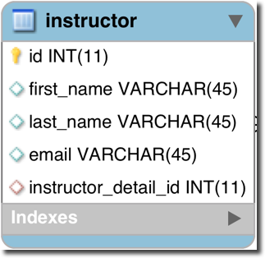
table: instructor
File: create-db.sql
…
CREATE TABLE `instructor` (
`id` int(11) NOT NULL AUTO_INCREMENT,
`first_name` varchar(45) DEFAULT NULL,
`last_name` varchar(45) DEFAULT NULL,
`email` varchar(45) DEFAULT NULL,
`instructor_detail_id` int(11) DEFAULT NULL,
PRIMARY KEY (`id`)
...
);

Slide 74
Foreign Key
Link tables together
A field in one table that refers to primary key in another table

Slide 75
Foreign Key Example
Foreign key column
Table: instructor
Table: instructor_detail

Slide 76



Defining Foreign Key
File: create-db.sql
…
CREATE TABLE `instructor` (
…
CONSTRAINT `FK_DETAIL` FOREIGN KEY (`instructor_detail_id`) REFERENCES `instructor_detail` (`id`)
);

Slide 77
More on Foreign Key
Main purpose is to preserve relationship between tables
Referential Integrity
•
Prevents operations that would destroy relationship
•
Ensures only valid data is inserted into the foreign key column
•
Can only contain valid reference to primary key in other table

Slide 78
Development Process: One-to-One
Step-By-Step
Prep Work - Define database tables
Create InstructorDetail class
Create Instructor class
Create Main App

Slide 79


Step 2: Create InstructorDetail class
@Entity @Table(name="instructor_detail") public class InstructorDetail {
@Id @GeneratedValue(strategy=GenerationType.IDENTITY) @Column(name="id")
private int id;
@Column(name="youtube_channel") private String youtubeChannel;
@Column(name="hobby") private String hobby;
// constructors
// getters / setters
}

Slide 80


Step 3: Create Instructor class
@Entity @Table(name="instructor") public class Instructor {
@Id @GeneratedValue(strategy=GenerationType.IDENTITY) @Column(name="id")
private int id;
@Column(name="first_name") private String firstName;
@Column(name="last_name") private String lastName;
@Column(name="email") private String email;
…
// constructors, getters / setters
}
www.luv2code.com

Slide 81



Step 3: Create Instructor class - @OneToOne
@Entity @Table(name="instructor") public class Instructor {
…
@OneToOne @JoinColumn(name=“instructor_detail_id") private InstructorDetail instructorDetail;
…
// constructors, getters / setters
}

Slide 82
Entity Lifecycle
Operations | Description
Detach | If entity is detached, it is not associated with a Hibernate session
Merge | If instance is detached from session, then merge will reattach to session
Persist | Transitions new instances to managed state. Next flush / commit will save in db.
Remove | Transitions managed entity to be removed. Next flush / commit will delete from db.
Refresh | Reload / synch object with data from db. Prevents stale data

Slide 83








Entity Lifecycle - session method calls
New / Transient
commit
save / persist
rollback / new
delete / remove
Persistent / Managed
refresh
Removed
persist/rollback
commit/rollback/close
merge
rollback
Detached

Slide 84
Cascade
Recall: You can cascade operations
•
Apply the same operation to related entities
Instructor Detail
Instructor
save

Slide 85


Cascade Delete
Foreign key column
Table: instructor
Table: instructor_detail

Slide 86
@OneToOne - Cascade Types
Cascade Type | Description
PERSIST | If entity is persisted / saved, related entity will also be persisted
REMOVE | If entity is removed / deleted, related entity will also be deleted
REFRESH | If entity is refreshed, related entity will also be refreshed
DETACH | If entity is detached (not associated w/ session), then related entity will also be detached
MERGE | If entity is merged, then related entity will also be merged
ALL | All of above cascade types

Slide 87



Configure Cascade Type
@Entity @Table(name="instructor") public class Instructor {
…
@OneToOne(cascade=CascadeType.ALL) @JoinColumn(name="instructor_detail_id") private InstructorDetail instructorDetail;
…
// constructors, getters / setters
}
By default, no operations are cascaded.

Slide 88

Configure Multiple Cascade Types
@OneToOne(cascade={CascadeType.DETACH, CascadeType.MERGE, CascadeType.PERSIST, CascadeType.REFRESH, CascadeType.REMOVE})

Slide 89



Step 4: Create Main App
public static void main(String[] args) {
…
// create the objects
Instructor tempInstructor = new Instructor("Chad", "Darby", "darby@luv2code.com");
InstructorDetail tempInstructorDetail =
new InstructorDetail(“http://www.luv2code.com/youtube", "Luv 2 code!!!");
// associate the objects tempInstructor.setInstructorDetail(tempInstructorDetail);
// start a transaction session.beginTransaction();
Instructor
Instructor
session.save(tempInstructor);
Detail
// commit transaction session.getTransaction().commit();
…
save
}

Slide 90
Hibernate One-to-One Bi-Directional

Slide 91
One-to-One Mapping
We currently have a uni-directional mapping
Instructor Detail
Instructor

Slide 92


New Use Case
If we load an InstructorDetail
Then we’d like to get the associated Instructor
•
Can’t do this with current uni-directional relationship :-(
Instructor Detail
Instructor

Slide 93


Bi-Directional
Bi-Directional relationship is the solution
•
We can start with InstructorDetail and make it back to the Instructor
Instructor Detail
Instructor

Slide 94
Bi-Directional - The Good News
•
To use Bi-Directional, we can keep the existing database schema
No changes required to database
•
Simply update the Java code

Slide 95
Development Process: One-to-One (Bi-Directional)
Make updates to InstructorDetail class:
Add new field to reference Instructor
Add getter/setter methods for Instructor
Add @OneToOne annotation
Create Main App
Step-By-Step

Slide 96

Step 1.2: Add getter/setter methods Instructor
@Entity @Table(name="instructor_detail") public class InstructorDetail {
…
private Instructor instructor; public Instructor getInstructor() {
return instructor;
}
public void setInstructor(Instructor instructor) { this.instructor = instructor;
}
…
}

Slide 97
Step 1.3: Add @OneToOne annotation
@Entity @Table(name="instructor_detail") public class InstructorDetail {
…
@OneToOne(mappedBy="instructorDetail") private Instructor instructor;
public Instructor getInstructor() { return instructor;
}
public void setInstructor(Instructor instructor) { this.instructor = instructor;
}
…
}
Refers to “instructorDetail” property in “Instructor” class

Slide 98


More on mappedBy
public class InstructorDetail {
…
@OneToOne(mappedBy="instructorDetail") private Instructor instructor;
•
mappedBy tells Hibernate
•
Look at the instructorDetail property in the Instructor class
•
Use information from the Instructor class @JoinColumn
•
To help find associated instructor
public class Instructor {
…
@OneToOne(cascade=CascadeType.ALL) @JoinColumn(name="instructor_detail_id") private InstructorDetail instructorDetail;

Slide 99
Add support for Cascading
Cascade all operations
@Entity @Table(name="instructor_detail") public class InstructorDetail {
…
to the associated Instructor
@OneToOne(mappedBy="instructorDetail", cascade=CascadeType.ALL) private Instructor instructor;
public Instructor getInstructor() { return instructor;
}
public void setInstructor(Instructor instructor) { this.instructor = instructor;
}
…
}

Slide 100



Step 2: Create Main App
public static void main(String[] args) {
…
// get the instructor detail object
int theId = 1;
InstructorDetail tempInstructorDetail = session.get(InstructorDetail.class, theId);
// print detail
System.out.println("tempInstructorDetail: " + tempInstructorDetail);
// print the associated instructor
System.out.println("the associated instructor: "
+ tempInstructorDetail.getInstructor());
…
}

Slide 101
Hibernate One-to-Many Bi-Directional

Slide 102



One-to-Many Mapping
An instructor can have many courses
Bi-directional
Course
Course
Instructor
Course
Course

Slide 103




Many-to-One Mapping
Many courses can have one instructor
Inverse / opposite of One-to-Many
Course
Course
Instructor
Course
Course

Slide 104





Real-World Project Requirement
If you delete an instructor, DO NOT delete the courses
If you delete a course, DO NOT delete the instructor
Do not apply cascading deletes!
Course
Course
Instructor
Course
Course

Slide 105
Development Process: One-to-Many
Step-By-Step
Prep Work - Define database tables
Create Course class
Update Instructor class
Create Main App

Slide 106

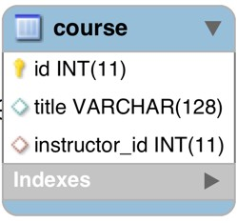


table: course
File: create-db.sql
CREATE TABLE `course` (
`id` int(11) NOT NULL AUTO_INCREMENT,
`title` varchar(128) DEFAULT NULL,
`instructor_id` int(11) DEFAULT NULL,
PRIMARY KEY (`id`),
UNIQUE KEY `TITLE_UNIQUE` (`title`),
...
);
Prevent duplicate course titles

Slide 107


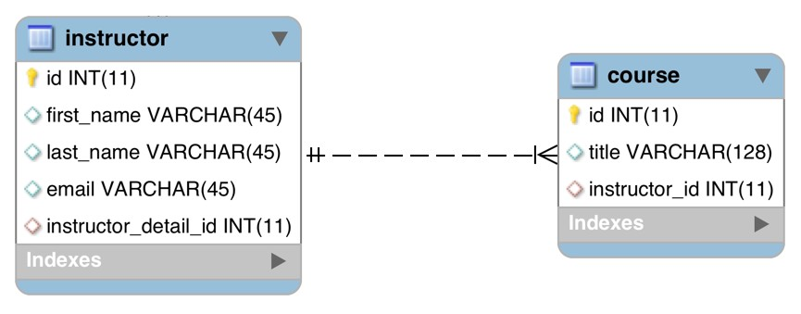
table: course - foreign key
File: create-db.sql
CREATE TABLE `course` (
…
KEY `FK_INSTRUCTOR_idx` (`instructor_id`),
CONSTRAINT `FK_INSTRUCTOR`
FOREIGN KEY (`instructor_id`)
REFERENCES `instructor` (`id`)
…
);

Slide 108

table: instructor - no changes

Slide 109



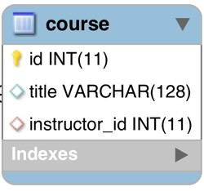
Step 2: Create Course class
@Entity @Table(name="course") public class Course {
@Id @GeneratedValue(strategy=GenerationType.IDENTITY) @Column(name="id")
private int id;
@Column(name="title") private String title;
…
// constructors, getters / setters
}

Slide 110



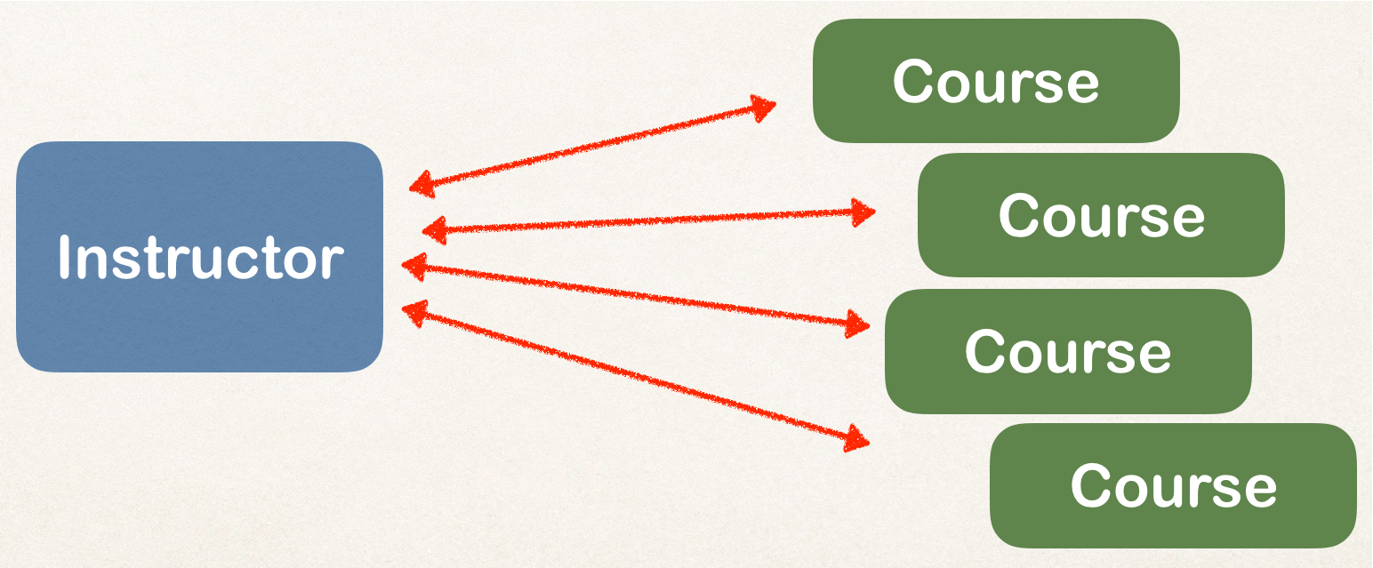
Step 2: Create Course class - @ManyToOne
@Entity @Table(name="course") public class Course {
…
@ManyToOne @JoinColumn(name="instructor_id") private Instructor instructor;
…
// constructors, getters / setters
}

Slide 111

Step 3: Update Instructor - reference courses
@Entity @Table(name="instructor") public class Instructor {
…
private List<Course> courses; public List<Course> getCourses() {
return courses;
}
public void setCourses(List<Course> courses) { this.courses = courses;
}
…
}

Slide 112
Add @OneToMany annotation
@Entity @Table(name="instructor") public class Instructor {
…
@OneToMany(mappedBy="instructor") private List<Course> courses;
public List<Course> getCourses() { return courses;
}
public void setCourses(List<Course> courses) { this.courses = courses;
}
…
}
Refers to “instructor” property in “Course” class

Slide 113
>
public class Instructor {
…
@OneToMany(mappedBy="instructor") private List<Course> courses;
•
mappedBy tells Hibernate
•
Look at the instructor property in the Course class
•
Use information from the Course class @JoinColumn
•
To help find associated courses for instructor
public class Course {
…
@ManyToOne @JoinColumn(name="instructor_id") private Instructor instructor;

Slide 114


Add support for Cascading
Do not apply cascading deletes!
@Entity @Table(name="instructor") public class Instructor {
…
@OneToMany(mappedBy="instructor", cascade={CascadeType.PERSIST, CascadeType.MERGE
CascadeType.DETACH, CascadeType.REFRESH}) private List<Course> courses;
…
}

Slide 115


Add support for Cascading
@Entity @Table(name="course") public class Course {
…
@ManyToOne(cascade={CascadeType.PERSIST, CascadeType.MERGE CascadeType.DETACH, CascadeType.REFRESH})
@JoinColumn(name="instructor_id") private Instructor instructor;
…
// constructors, getters / setters
}
Do not apply
cascading deletes!

Slide 116


Add convenience methods for bi-directional
@Entity @Table(name="instructor") public class Instructor {
…
// add convenience methods for bi-directional relationship
public void add(Course tempCourse) { if (courses == null) {
courses = new ArrayList<>();
}
courses.add(tempCourse); tempCourse.setInstructor(this);
}
…
}

Slide 117

Step 2: Create Main App
public static void main(String[] args) {
…
// get the instructor object
int theId = 1;
Instructor tempInstructor = session.get(Instructor.class, theId);
// print instructor
System.out.println("tempInstructor: " + tempInstructor);
// print the associated courses
System.out.println("courses: " + tempInstructor.getCourses());
…
}

Slide 118
Fetch Types: Eager vs Lazy

Slide 119
Fetch Types: Eager vs Lazy Loading
When we fetch / retrieve data, should we retrieve EVERYTHING?
Eager will retrieve everything
Lazy will retrieve on request
Course
Course
Instructor
Course
Course

Slide 120




Eager Loading
•
Eager loading will load all dependent entities
•
Load instructor and all of their courses at once
Course
Course
Instructor
Course
Course

Slide 121
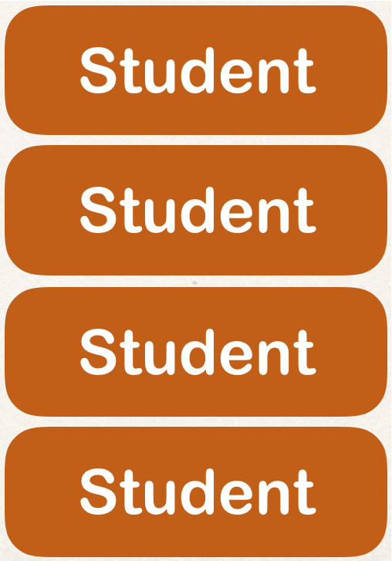




Eager Loading
What about course and students?
Could easily turn into a performance nightmare …
Course

Slide 122
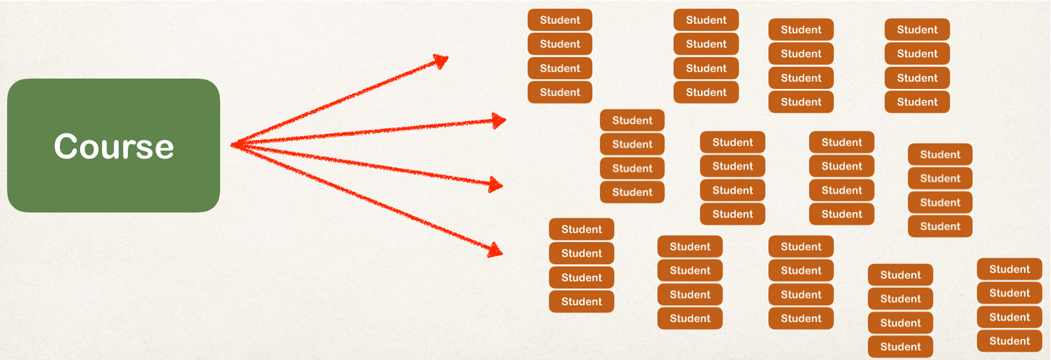
Eager Loading
In our app, if we are searching for a course by keyword
Only want a list of matching courses
•
Eager loading would still load all students for each course …. not good!

Slide 123


Best Practice
Only load data when absolutely needed
Prefer Lazy loading instead of
Eager loading

Slide 124



Lazy Loading
Lazy Loading is preferred
Lazy loading will load the main entity first
Load dependent entities on demand (lazy)
Load on demand (lazy)
Load course first

Slide 125
Real-World Use Case
•
In Master view, use lazy loading
•
In Detail view, retrieve the entity and necessary dependent entities

Slide 126

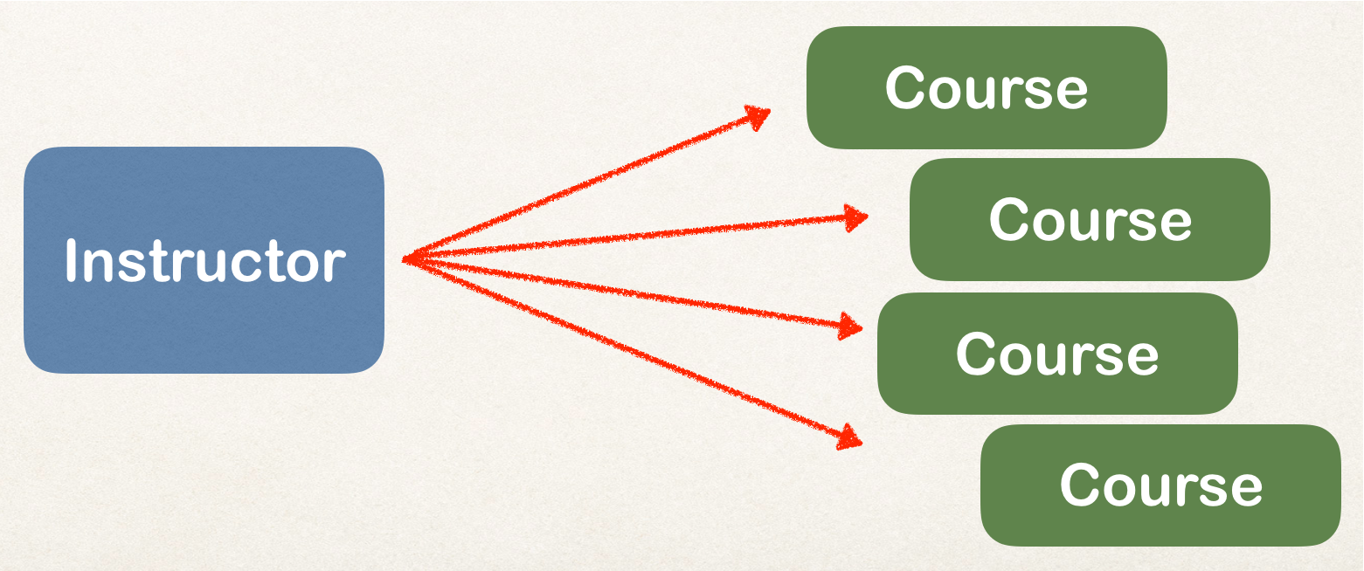

Fetch Type
When you define the mapping relationship
You can specify the fetch type: EAGER or LAZY
@Entity @Table(name="instructor") public class Instructor {
…
@OneToMany(fetch=FetchType.LAZY, mappedBy=“instructor”) private List<Course> courses;
…
}

Slide 127
Default Fetch Types
Mapping | Default Fetch Type
@OneToOne | FetchType.EAGER
@OneToMany | FetchType.LAZY
@ManyToOne | FetchType.EAGER
@ManyToMany | FetchType.LAZY

Slide 128
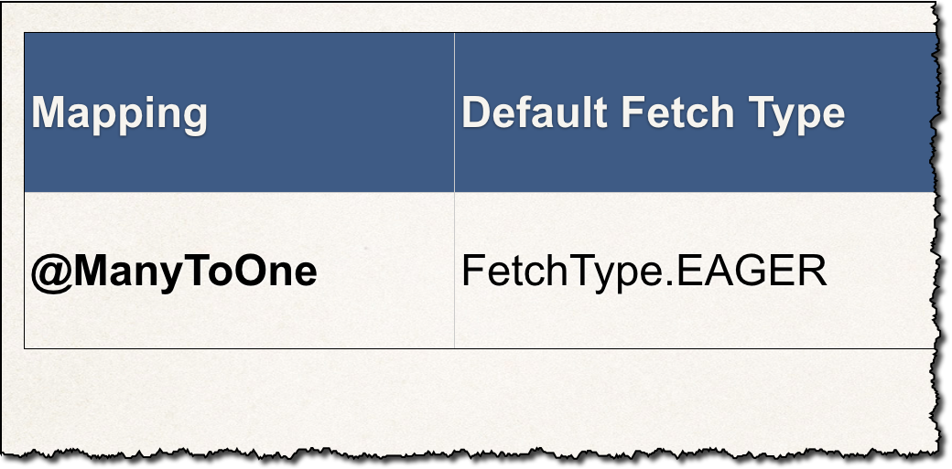

Overriding Default Fetch Type
Specifying the fetch type, overrides the defaults
@ManyToOne(fetch=FetchType.LAZY) @JoinColumn(name="instructor_id") private Instructor instructor;

Slide 129
More about Lazy Loading
•
When you lazy load, the data is only retrieved on demand
•
However, this requires an open Hibernate session
need an connection to database to retrieve data

Slide 130

More about Lazy Loading
•
If the Hibernate session is closed
•
And you attempt to retrieve lazy data
•
Hibernate will throw an exception
Watch out for this!

Slide 131
More about Lazy Loading
To retrieve lazy data, you will need to open a Hibernate session
•
Retrieve lazy data using
•
Option 1: session.get and call appropriate getter method(s)
•
Option 2: Hibernate query with HQL
•
Many other techniques available but the two above are most common

Slide 132
Hibernate One-to-Many Uni-Directional

Slide 133



One-to-Many Mapping
A course can have many reviews
Uni-directional
Review
Review
Course
Review
Review

Slide 134




Real-World Project Requirement
If you delete a course, also delete the reviews
Reviews without a course … have no meaning
Review
Apply cascading deletes!
Review
Course
Review
Review

Slide 135

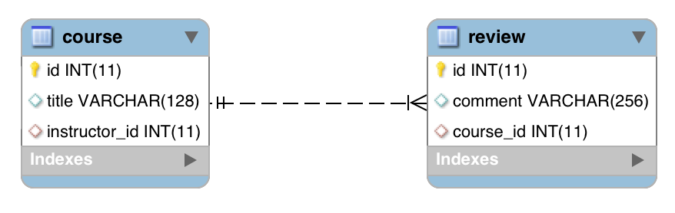
@OneToMany
@OneToMany (uni)

Slide 136
Development Process: One-to-Many
Step-By-Step
Prep Work - Define database tables
Create Review class
Update Course class
Create Main App

Slide 137


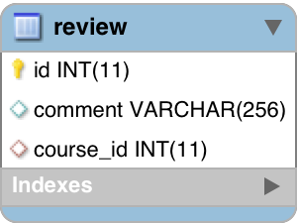
table: review
File: create-db.sql
comment:
“Wow … this course is awesome!”
CREATE TABLE `review` (
`id` int(11) NOT NULL AUTO_INCREMENT,
`comment` varchar(256) DEFAULT NULL,
`course_id` int(11) DEFAULT NULL,
...
);

Slide 138


table: review - foreign key
File: create-db.sql
CREATE TABLE `review` (
…
KEY `FK_COURSE_ID_idx` (`course_id`),
CONSTRAINT `FK_COURSE`
FOREIGN KEY (`course_id`)
REFERENCES `course` (`id`)
…
);
Table
Column

Slide 139

table: course - no changes

Slide 140

Step 2: Create Review class
@Entity @Table(name="review") public class Review {
@Id @GeneratedValue(strategy=GenerationType.IDENTITY) @Column(name="id")
private int id;
@Column(name="comment") private String comment;
…
// constructors, getters / setters
}

Slide 141

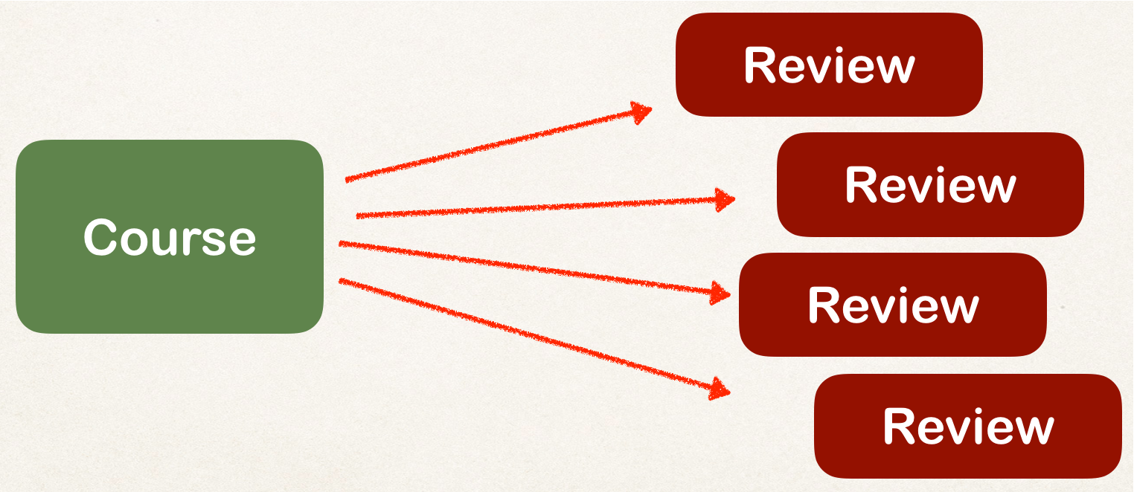
Step 3: Update Course - reference reviews
@Entity @Table(name="course") public class Course {
…
private List<Review> reviews;
// getter / setters
…
}

Slide 142

Add @OneToMany annotation
Refers to “course_id” column in “review” table
@Entity @Table(name="course") public class Course {
…
@OneToMany @JoinColumn(name="course_id") private List<Review> reviews;
// getter / setters
…
}

Slide 143


More: @JoinColumn
public class Course {
…
@OneToMany @JoinColumn(name="course_id") private List<Review> reviews;
•
In this scenario, @JoinColumn tells Hibernate
•
Look at the course_id column in the review table
•
Use this information to help find associated reviews for a course

Slide 144


Add support for Cascading
Cascade all operations including deletes!
@Entity @Table(name="course") public class Course {
…
@OneToMany(cascade=CascadeType.ALL) @JoinColumn(name="course_id")
private List<Review> reviews;
…
}

Slide 145

Add support for Lazy loading
Lazy load the
@Entity @Table(name="course") public class Course {
…
reviews
@OneToMany(fetch=FetchType.LAZY, cascade=CascadeType.ALL) @JoinColumn(name="course_id")
private List<Review> reviews;
…
}

Slide 146

Add convenience method for adding review
@Entity @Table(name="course") public class Course {
…
// add convenience methods for adding reviews
public void add(Review tempReview) { if (reviews == null) {
reviews = new ArrayList<>();
}
reviews.add(tempReview);
}
…
}

Slide 147


Step 4: Create Main App
public static void main(String[] args) {
…
// get the course object
int theId = 10;
Course tempCourse = session.get(Course.class, theId);
Lazy load the reviews
// print the course
System.out.println("tempCourse: " + tempCourse);
// print the associated reviews
System.out.println("reviews: " + tempCourse.getReviews());
…
}

Slide 148
Hibernate Many-to-Many

Slide 149
Many-to-Many Mapping
A course can have many students
A student can have many courses
Course
Student
Course
Student
Course
Student
Course
Student

Slide 150





Keep track of relationships
•
Need to track which student is in which course and vice-versa
Course
Student
Course
Student
Join Table
Course
Student
Course
Student

Slide 151

Join Table
A table that provides a mapping between two tables.
It has foreign keys for each table to define the mapping relationship.

Slide 152

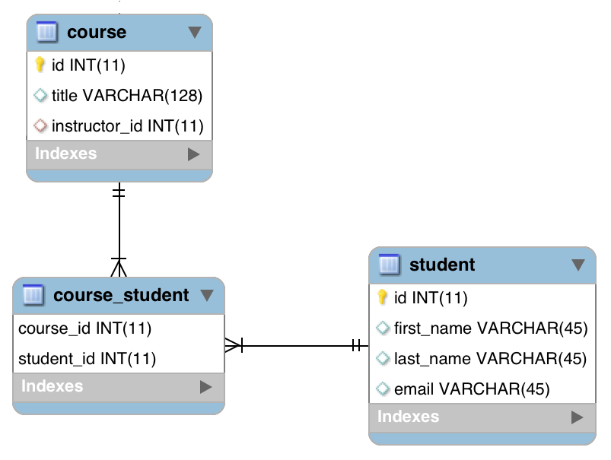

@ManyToMany
Join Table

Slide 153

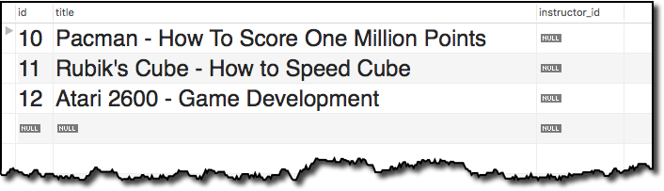

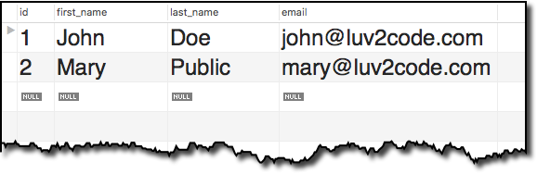
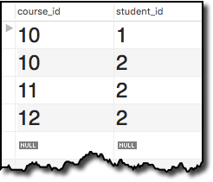

Join Table Example
Find John’s Courses
- Pacman
Join Table

Slide 154


Join Table Example
Find Mary’s Courses
Pacman
Rubik’s Cube
Atari 2600

Slide 155
Development Process: Many-to-Many
Step-By-Step
Prep Work - Define database tables
Update Course class
Update Student class
Create Main App

Slide 156

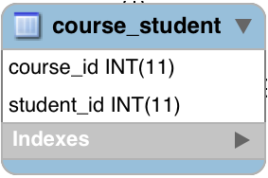

join table: course_student
File: create-db.sql
CREATE TABLE `course_student` (
`course_id` int(11) NOT NULL,
`student_id` int(11) NOT NULL,
PRIMARY KEY (`course_id`, `student_id`),
...
);

Slide 157


join table: course_student - foreign keys
CREATE TABLE `course_student` (
…
CONSTRAINT `FK_COURSE_05`
FOREIGN KEY (`course_id`)
REFERENCES `course` (`id`),
CONSTRAINT `FK_STUDENT`
FOREIGTNabKlEeY (`student_id`_{C}) _{olumn}
REFERENCES `student` (`id`)
…
);
Table
Column

Slide 158

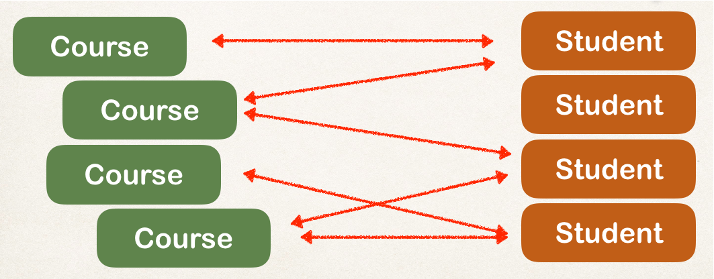
Step 2: Update Course - reference students
@Entity @Table(name="course") public class Course {
…
private List<Student> students;
// getter / setters
…
}

Slide 159






Add @ManyToMany annotation
@Entity @Table(name="course") public class Course {
…
^{Refers to “co}R^{ur}e^{s}fer_s^{id}t”o^{c}“ºs^{l}t^{u}u^{m}de^{n}nt_id” column in “course_st_{i}u_{n}d“e_{c}n_{o}t”_{ur}jo_{se}in_{_s}ta_{tu}b_{d}le_{ent” join table}
@ManyToMany @JoinTable(
name="course_student", joinColumns=@JoinColumn(name="course_id"), inverseJoinColumns=@JoinColumn(name="student_id")
)
private List<Student> students;
// getter / setters
…
}

Slide 160





More: @JoinTable
@JoinTable tells Hibernate
Look at the course_id column in the course_student table
For other side (inverse), look at the student_id column in the course_student table
Use this information to find relationship between course and students
public class Course {
@ManyToMany @JoinTable(
name="course_student", joinColumns=@JoinColumn(name="course_id"), inverseJoinColumns=@JoinColumn(name="student_id")
)
private List<Student> students;
}

Slide 161



More on “inverse”
In this context, we are defining the relationship in the Course class
The Student class is on the “other side” … so it is considered the “inverse”
“Inverse” refers to the “other side” of the relationship
We are here
Inverse / other side

Slide 162

Now, let’s do a similar thing for Student
just going the other way …

Slide 163
Step 3: Update Student - reference courses
@Entity @Table(name="student") public class Student {
…
private List<Course> courses;
// getter / setters
…
}

Slide 164

Add @ManyToMany annotation
@Entity @Table(name="student") public class Student {
…
Refers to “student_id” column
in “cours_{R}e_{e}__{f}s_{e}t_{r}u_{s}d_{t}e_{o}n“t_{c}”_{o}jo_{u}i_{r}n_{se}ta_b_{id}le_{” column}
in “course_student” join table
@ManyToMany @JoinTable(
name="course_student", joinColumns=@JoinColumn(name="student_id"), inverseJoinColumns=@JoinColumn(name="course_id")
)
private List<Course> courses;
// getter / setters
…
}

Slide 165





More: @JoinTable
@JoinTable tells Hibernate
Look at the student_id column in the course_student table
For other side (inverse), look at the course_id column in the course_student table
Use this information to find relationship between student and courses
public class Student {
@ManyToMany @JoinTable(
name="course_student", joinColumns=@JoinColumn(name="student_id"), inverseJoinColumns=@JoinColumn(name="course_id")
)
private List<Course> courses;
}

Slide 166


More on “inverse”
In this context, we are defining the relationship in the Student class
The Course class is on the “other side” … so it is considered the “inverse”
“Inverse” refers to the “other side” of the relationship
Inverse / other side
We are here

Slide 167
Step 4: Create Main App
public static void main(String[] args) {
…
// get the course object
int theId = 10;
Course tempCourse = session.get(Course.class, theId);
// print the course
System.out.println("tempCourse: " + tempCourse);
// print the associated students
System.out.println("students: " + tempCourse.getStudents());
…
}

Slide 168

Real-World Project Requirement
DO NOT
apply cascading deletes!
•
If you delete a course, DO NOT delete the students
Course
Student
Course
Student
Course
Student
Course
Student

Slide 169
Other features
In the next set of videos, we’ll add support for other features
•
Lazy Loading of students and courses
•
Cascading to handle cascading saves … but NOT deletes
If we delete a course, DO NOT delete students
If we delete a student, DO NOT delete courses

